Slide 1
Anvil Ascension
Postmortem

Slide 2
Introduce The Team
Adam Denomme – Lead Programmer
George Dixon – Generalist
Julian Voros – Gameplay Programmer
John Sauve – Generalist
Kenneth Little – Graphics Programmer

Slide 3
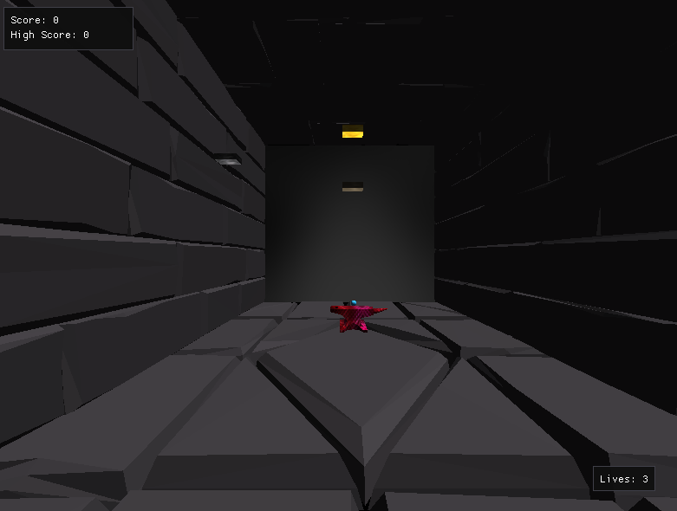
Introduce The Game
This is anvil ascension
Our game uses OpenGL and the FLECS API, to make an Arkanoid-inspired dungeon brick-breaker

Slide 4
Demo The Game (For a few minutes)

Slide 5
What Went Right?
Good Communication
People were driven to get stuff done
Collaborative skills were good
Jumping from one code sample to another was not terrible
Continued dedication to fixing things
Good research skills employed to help
Supportive teammates

Slide 6
What Went Wrong?
We had a few things that didn’t go as we wanted
Transition from object-oriented to data-oriented was not smooth
Most of the team had to learn OpenGL
Registering entities took a while
Used a different base game halfway through to help our renderer work
Trying to figure out physics logic and how we can add it
Getting the collisions to work seemed like our biggest struggle
Major burnout by week 3
Boundaries were a big issue as our Python script wasn’t working properly
Our game cant make the brick disappear
Overall game isn’t finished but its close

Slide 7
Lessons Learned
The game was a bit more challenging than we had initially thought
If we could rewind time, we probably would’ve switched to directX11 and have teammates shoulder less work and try to split the work up more
We would have prioritized understanding each other’s code and what we did and did not need to add
We communicated a perfect amount I’d say
I think the sprint-based workflow helped us to pace ourselves

Slide 8
Audience Questions and Answers

